Slide 1

PLANT DISEASE DETECTION USING CNN
Under the guidance of
Dr. Devichand P. Rathod
Professor Electrical Department
1] Harshal Bagul (101090030)
2] Abhishrut Vaidya(141090031)
3] Aniket Polawar(141090032)
4] Yogesh Bacchewar(141090033)
5] Tushar Ghule (141090046)

Slide 2
INTRODUCTION
Disease in plants can cause major production and economic loss in agricultural industry . Early information on crop health and disease detection can facilitate the control of disease.
Detection and recognition of diseases in plants mistreatment digital image method is extremely effective in providing symptoms of characteristic diseases at its early stages.
The diseases are mostly on leaves and on stem of plant. The diseases are viral, bacterial, fungal, diseases due to insects, rust, nematodes etc. on plant.

Slide 3
OBJECTCIVE
Plant disease is detected with the help of image processing .
Features will be fetched from the diseased plant image and will be used as a data.
Algorithm will be trained using machine learning for further feature detection of fresh image .
Digital image process has terribly important role in agriculture field. it's widely accustomed observe the crop disease with high accuracy.

Slide 4
Literature Review
Fruits and leaves disease monitoring by app plantix using machine learning.
Plant disease detection by uploading image on website GreenR.
KNN, SVM and ANN Based Classification of Plant Diseases

Slide 5
Different methods
Neural network with back propagation supervised data
Support vector machine(SVM)
Supervised learning algorithm for classification
CNN(Convolutional neural network)
Using many convolution layers.

Slide 6
PROCESS STEPS
Image data
Image preprocessing
Designing Architecture
Training the architecture
Detection and classification of plant disease.

Slide 7
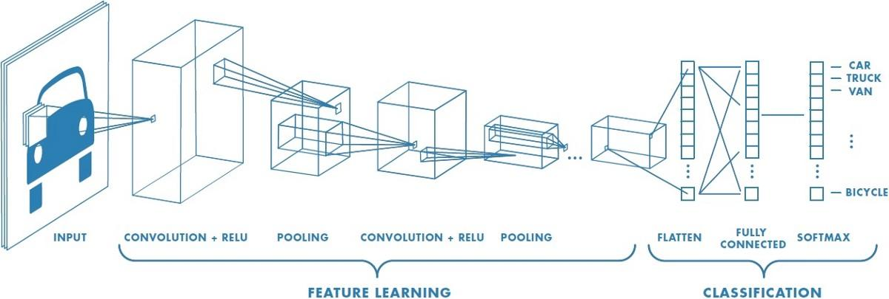
About CNN

Slide 8
Why CNN ?
No explicit need of image processing
Ruggedness to shifts and distortion in the image
Easier and better training
Highly flexible for any data set

Slide 9
Different architectures in CNN
VGG16
Resnet50
Inception50

Slide 10
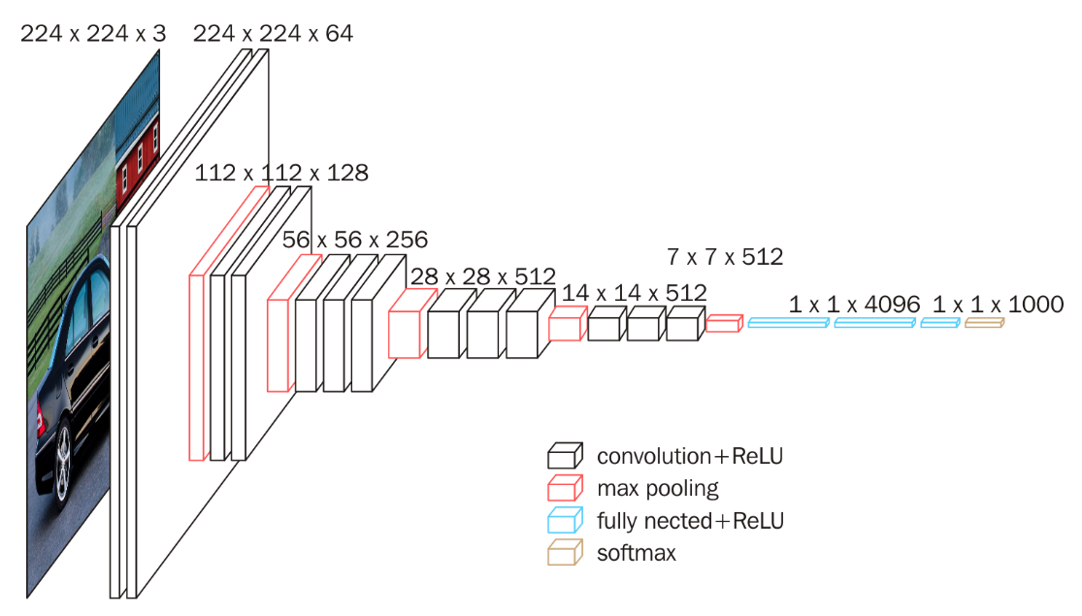
VGG16
VGG16 model, with weights pre-trained on ImageNet.

Slide 11
Methodology :
1] Select method and architecture.
2] Collect data from Plant image.
3] Augmentation of image data. => reduce overfitting
4] Training with 6 epochs and transfer learning.
5] Apply prediction and get confusion matrix.
6] Testing on image taken by Raspberry-pi camera and interfacing.

Slide 12
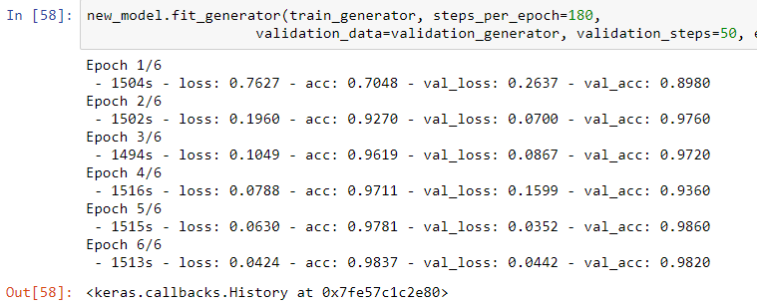
Software Training

Slide 13
Inference from the training losses
Underfitting – Validation and training error high
Overfitting – Validation error is high, training error low
Good fit – Validation error low, slightly higher than the training error
Unknown fit - Validation error low, training error 'high'

Slide 14
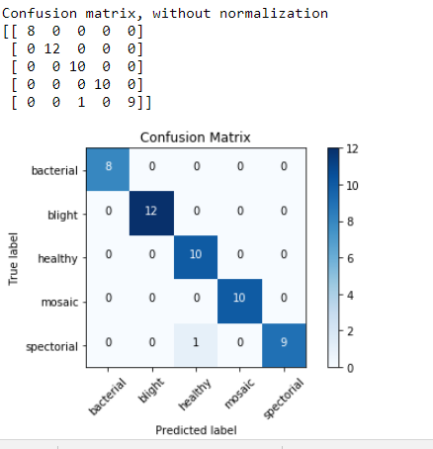
Training results for test batch : 50

Slide 15
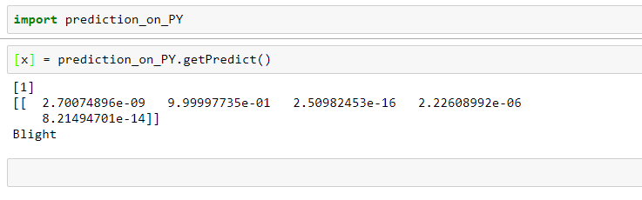
Testing :

Slide 16

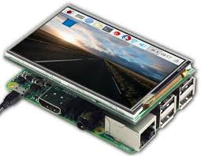
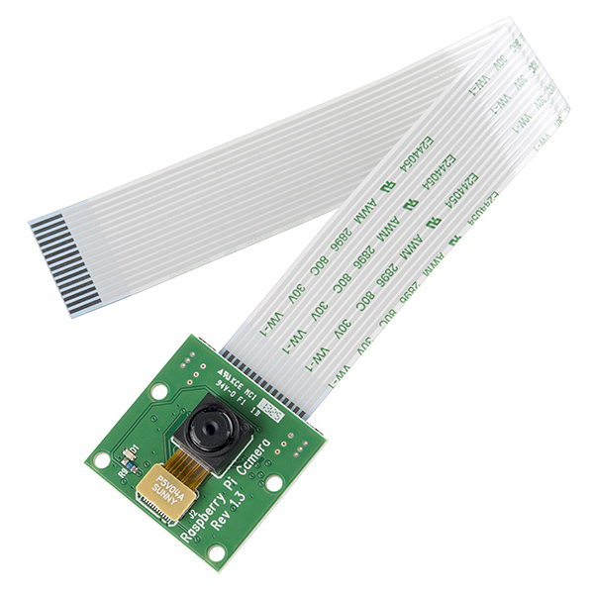
Interfacing :

Slide 17
Device Setup
Installing Raspbian OS to the Raspberry pi 3
Connecting Camera module to the Raspberry pi 3
Enabling Camera access of the raspi
Connecting raspi to the same network as the local host
As now camera module,raspi and local host(PC) are connected to each other

Slide 18
Software Requirements
Raspberry pi 3 works on the Raspbian-Jessie OS
Raspberry pi requires Python3.6 installed
GUI is supported by the Tkinter (python3 based)
Local host works on the Ubuntu-18.04-LTS
Local host requires Python3.6 installed along with Keras libraries loaded
Keras uses Tensorflow backend of the latest version
Local host uses Tkintet Python3 based GUI
Also, SSH must be enabled on both the raspi and localhost

Slide 19
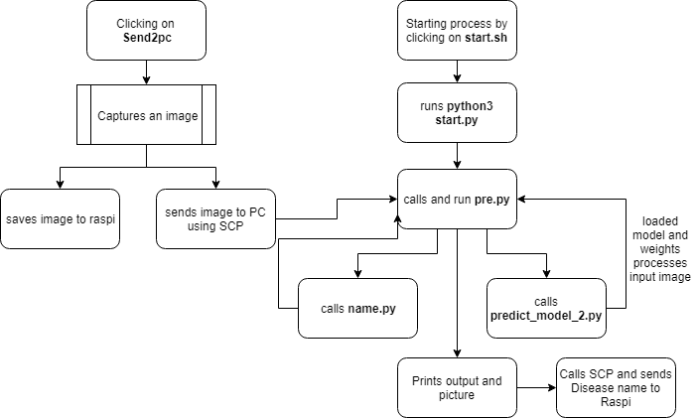
Procedure Flowchart

Slide 20
Detailed Procedure
Enabling SSH on both Raspberry pi 3 and local host
Taking picture of leaf by clicking on the icon ‘Send2pc’ on raspi Desktop
Clicking this also copies same image instantly to the PC
On PC, clicking on ‘start.sh’ file to execute the start procedure
Now ‘START’ button will appear
Clicking on that will opens a dialog box from which we select the recieved image
Image gets processed by the loaded trained model ‘vgg_model_class5.h5’ and by loaded weightes ‘finetune_VGG_class5.h5’
The output we recieve is the display of the image and name of the disease

Slide 21
Why Tomato
India is second largest tomato producer in world.
Tomato is short duration and high yielding product.
Suffers from many diseases.
Large dataset is available.

Slide 22
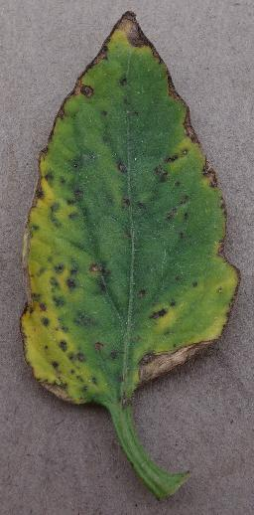
Diseases we are recognizing :
Bacterial
Copper fungicide spray

Slide 23
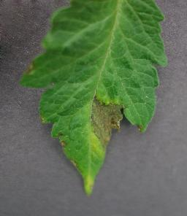
Blight
Dithane M-45
fungicide

Slide 24
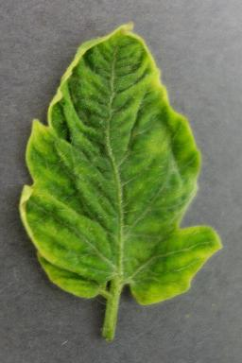
Mosaic
No remedy

Slide 25
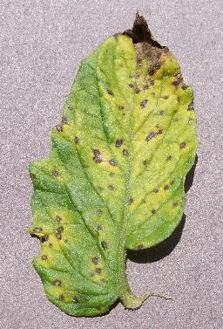
Septoria
Maneb and
Chlorothalonil
fungicides

Slide 26
USE
Can be used to predict the disease early and precautions could be taken.
Can be used in whole farming industry.

Slide 27
FUTURE SCOPE
1.Restricted for only one type of crop, but in future same idea can be implemented for various types.
2.In future we can also look for characteristics of other parts of plant like stem,fruit or flower.
3. Can also be performed with the help of satellite using IR images thus eliminating need of manual capturing of image.

Slide 28
CONCLUSION
1.CNN architecture was suggested to apply to tomato disease classification task.
2.The results also show that the proposed VGG networks works effectively and accurately.
3.Our proposed system will make a significant contribution to the agriculture research area.
4.Promising application will be to extend the idea of diseases and pest recognition to other crops.

Slide 29
REFERENCES
1. Aakanksha Rastogi, Ritika Arora, Shanu Sharma, “Leaf Disease Detection and Grading using Computer Vision Technology &Fuzzy Logic,” presented at the 2nd International Conference on Signal Processing and Integrated Networks (SPIN), IEEE, 2015, pp. 500–505.
2. . Garima Tripathi, Jagruti Save, “AN IMAGE PROCESSING AND NEURAL NETWORK BASED APPROACH FOR DETECTION AND CLASSIFICATION OF PLANT LEAF DISEASES,” Int. J. Comput. Eng. Technol. IJCET, vol. 6, no. 4, pp. 14–20, Apr. 2015.
3. S. Arivazhagan, R. Newlin Shebiah, S. Ananthi, S. Vishnu Varthini, “Detection of unhealthy region of plant leaves and classification of plant leaf diseases using texture features,” Agric Eng Int CIGR J., vol. 15, no. 1, pp. 211–217, Mar. 2013.
4. K. Muthukannan, P. Latha, R. PonSelvi and P. Nisha, “CLASSIFICATION OF DISEASED PLANT LEAVES USING NEURAL NETW ORK ALGORITHMS,” ARPN J. Eng. Appl. Sci., vol. 10, no. 4, pp. 1913–1918, Mar. 2015.
5. H. Al-Hiary, S. Bani-Ah Mad, M. Reyalat, M. Braik And Z. A Lrahamneh, Fast And Accurate Detection And Classification Of Plant Diseases, IJCA, 2011, 17(1), 31-38, IEEE-2010

Slide 30
6. Sanjeev S. Sannakki, Vijay S Rajpurohit, V. B. Nargund and Pallavi Kulkarni, “Diagnosis and Classification of Grape Leaf Diseases using Neural Networks”, International Conference Communications and Networking Technologies IEEE, 2013.
7. Digital Image Processing Textbook(3rd Edition)Aug 31, 2007by Rafael C. Gonzalez and Richard E. Woods.
8. Hands-On Machine Learning with Scikit-Learn and TensorFlow: Concepts, Tools, and Techniques to Build Intelligent Systems 1st Edition
9. https://keras.io/applications/#vgg16
10. https://www.raspberrypi.org/
11. https://www.coursera.org/learn/machine-learning

Slide 31
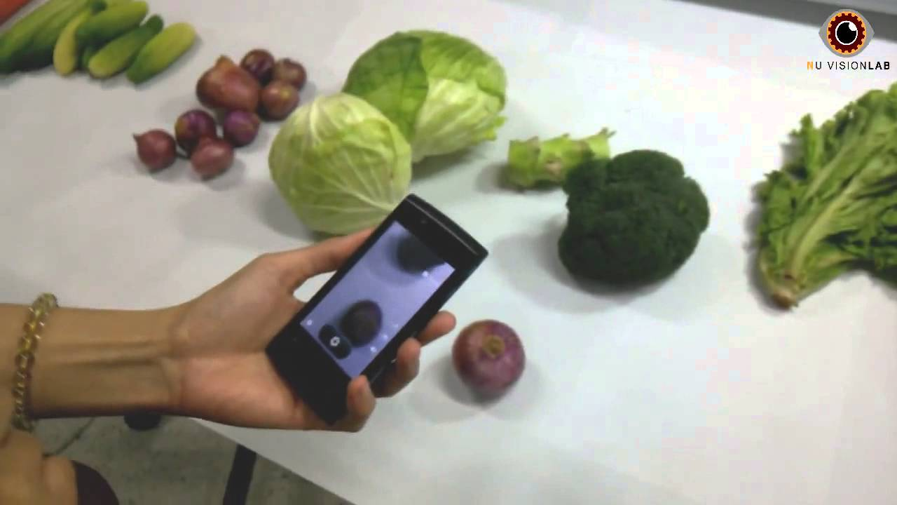
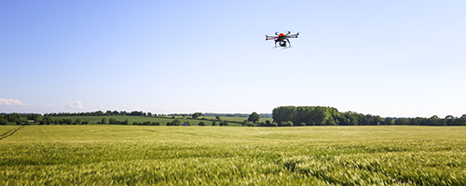
THANK YOU

